Slide 1
Weekly Meeting
Nov 20, 2021
Gwangwoo Kim

Slide 2
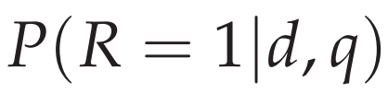
11.2 The Probability Ranking Principle
$R_{d,q}$ = an indicator random variable
Using a probabilistic model, the obvious order in which to present documents to the user is to rank documents by their estimated probability of relevance with respect to the information need:

Slide 3

11.2 The Probability Ranking Principle
If a set of retrieval results is to be returned, rather than an ordering, the Bayes Optimal Decision Rule, the decision which minimizes the risk of loss, is to simply return documents that are more likely relevant than nonrelevant:

Slide 4
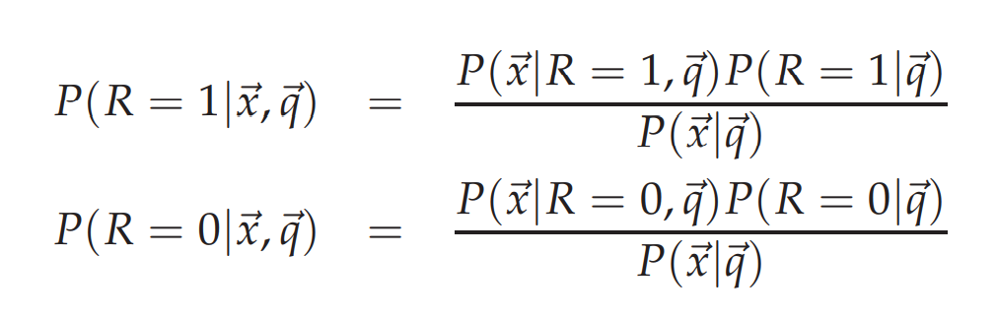
11.3 The Binary Independence Model

Slide 5
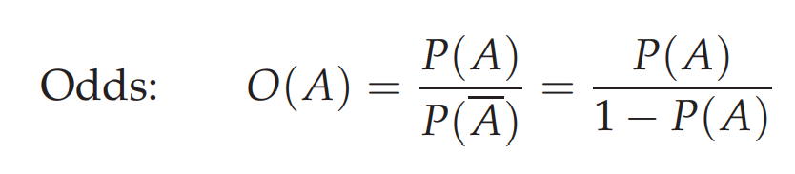
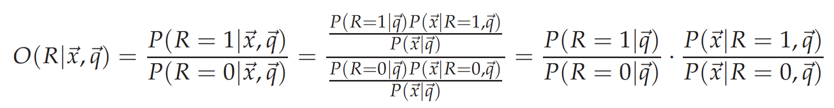
11.3.1 Deriving a ranking function for query terms
constant

Slide 6
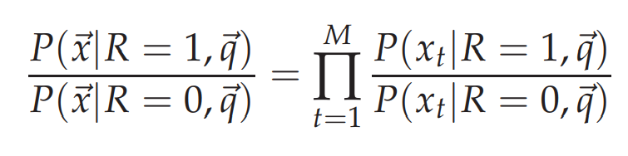
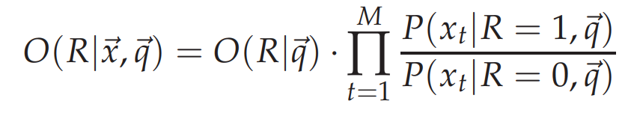
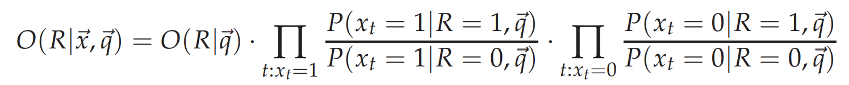
11.3.1 Deriving a ranking function for query terms
assumption

Slide 7
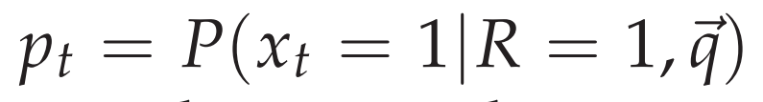
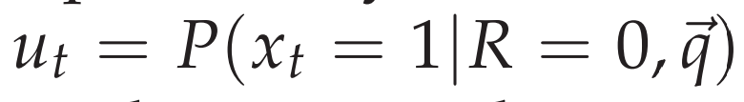
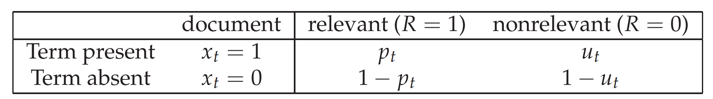
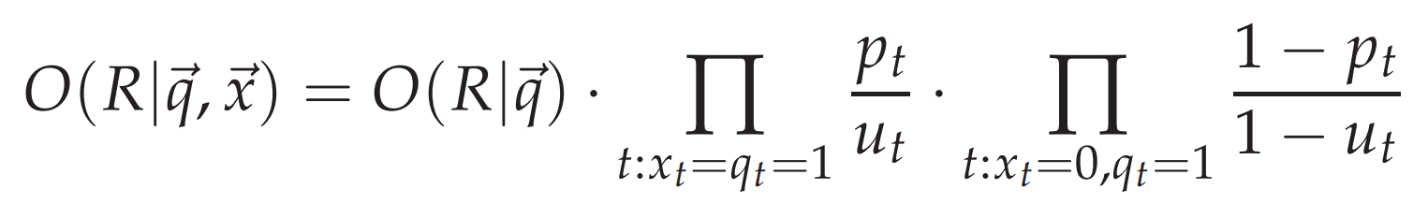
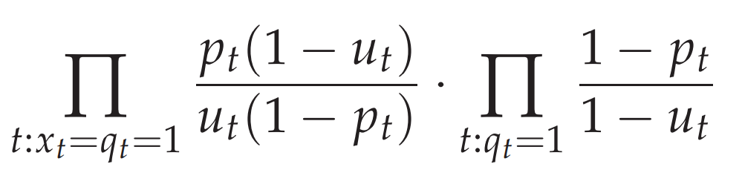
11.3.1 Deriving a ranking function for query terms
constant

Slide 8
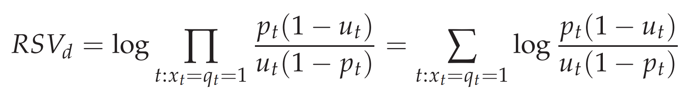
11.3.1 Deriving a ranking function for query terms
Retrieval status value

Slide 9
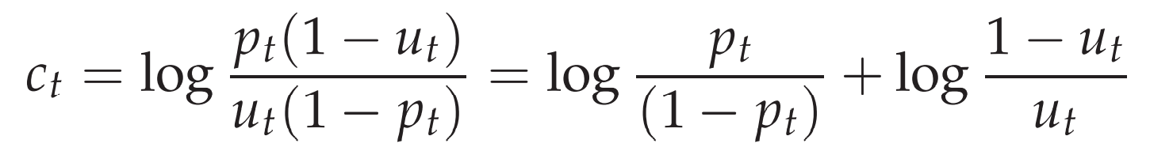

11.3.1 Deriving a ranking function for query terms
How to estimate $c_{t}$?

Slide 10
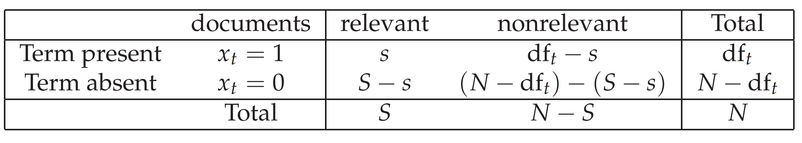
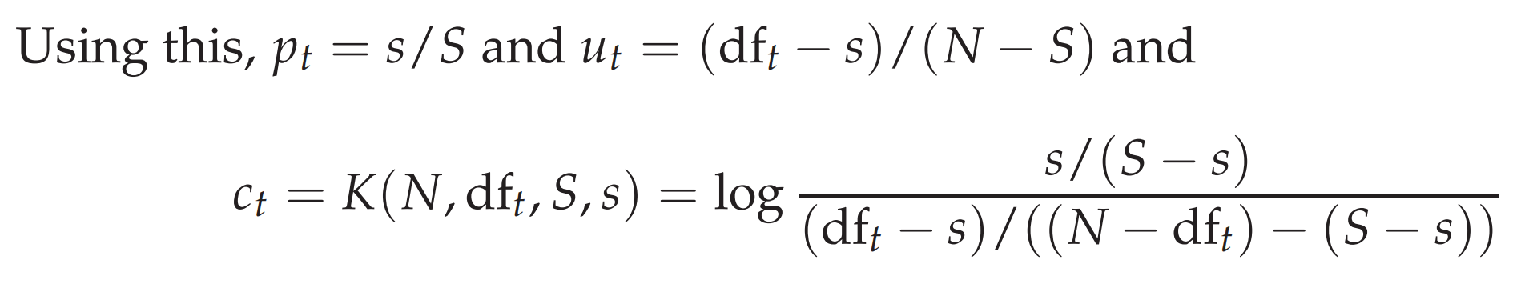
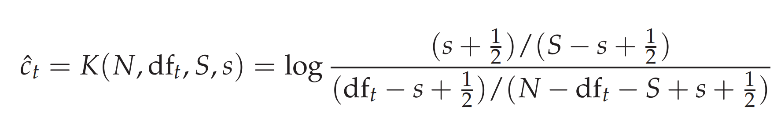
11.3.2 Probability estimates in theory

Slide 11
11.3.2 Probability estimates in theory
Simultaneously decreasing the estimated probability of seen events and increasing the probability of unseen events is referred to as smoothing.
One simple way of smoothing is to add a number α to each of the observed counts,
where the size of α denotes the strength of our belief in uniformity. (Since our belief in uniformity is weak, we use α = ½.)
This is a form of maximum a posteriori (MAP) estimation

Slide 12
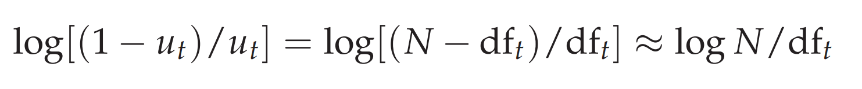
11.3.3 Probability estimates in practice
Under the assumption that relevant documents are a very small percentage of the collection

Slide 13
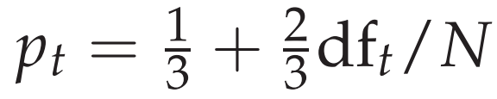
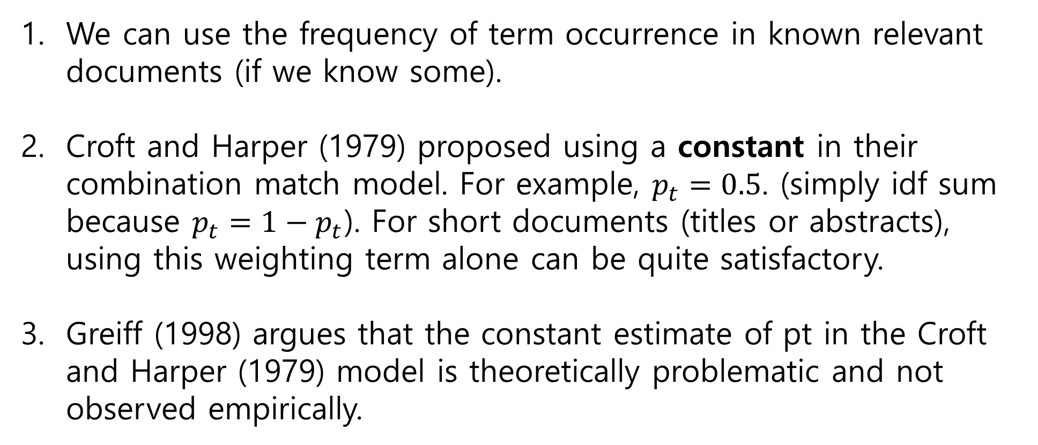
11.3.3 Probability estimates in practice
We can use the frequency of term occurrence in known relevant documents (if we know some).
Croft and Harper (1979) proposed using a constant in their combination match model. For example, $p_{t}=0.5$. (simply idf sum because $p_{t}=1−p_{t}$). For short documents (titles or abstracts), using this weighting term alone can be quite satisfactory.
Greiff (1998) argues that the constant estimate of pt in the Croft and Harper (1979) model is theoretically problematic and not observed empirically.

Slide 14
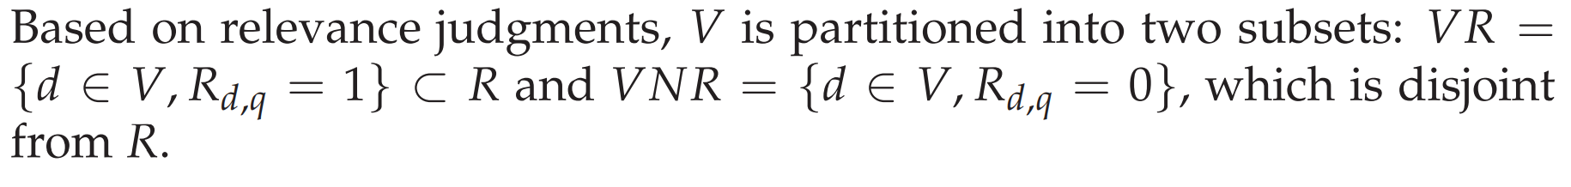
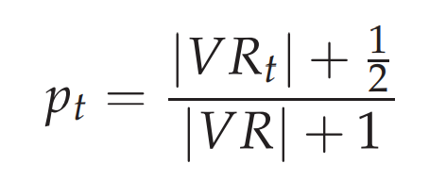
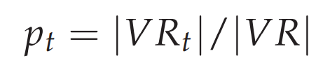
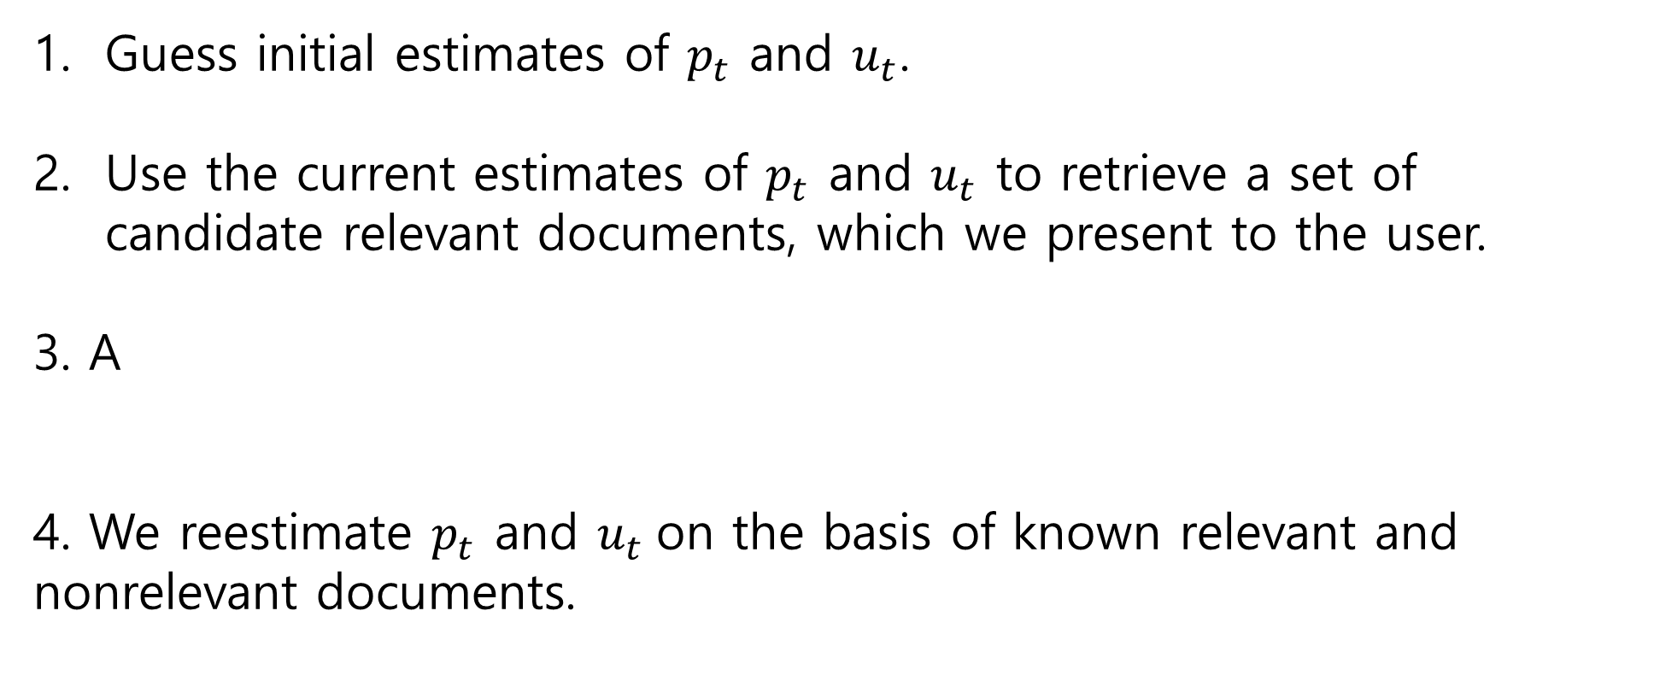
11.3.4 Probabilistic approaches to relevance feedback
Guess initial estimates of $p_{t}$ and $u_{t}$.
Use the current estimates of $p_{t}$ and $u_{t}$ to retrieve a set of candidate relevant documents, which we present to the user.
3. A
4. We reestimate $p_{t}$ and $u_{t}$on the basis of known relevant and nonrelevant documents.

Slide 15
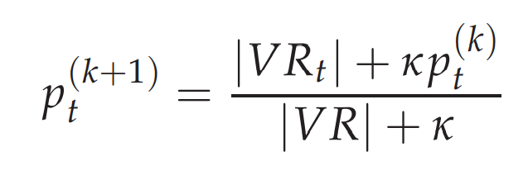
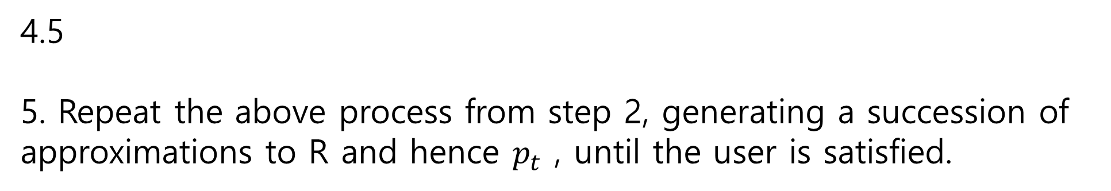
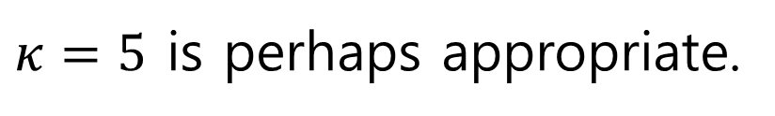
11.3.4 Probabilistic approaches to relevance feedback
$κ=5$ is perhaps appropriate.
4.5
5. Repeat the above process from step 2, generating a succession of approximations to R and hence $p_{t}$ , until the user is satisfied.

Slide 16
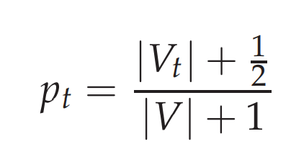

11.3.4 Probabilistic approaches to relevance feedback
If VR=V,
We can use the frequency of term occurrence in known relevant documents (if we know some).
Determine a guess for the size of the relevant document set. If unsure, a conservative (too small) guess is likely to be best.
Improve our guesses for $p_{t}$ and $u_{t}$.

Slide 17
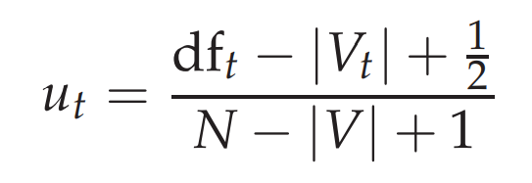

11.3.4 Probabilistic approaches to relevance feedback
If we assume that documents that are not retrieved are nonrelevant then we can update our $u_{t}$ estimates as:
4. Go to step 2 until the ranking of the returned results converges.

Slide 18
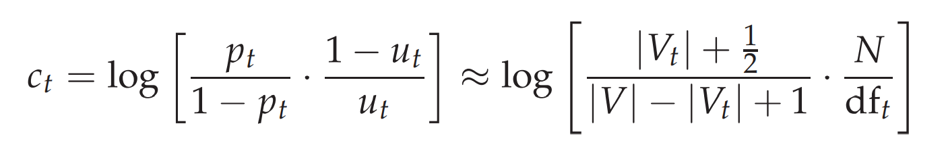
11.3.4 Probabilistic approaches to relevance feedback
This is like tf-idf!

Slide 19
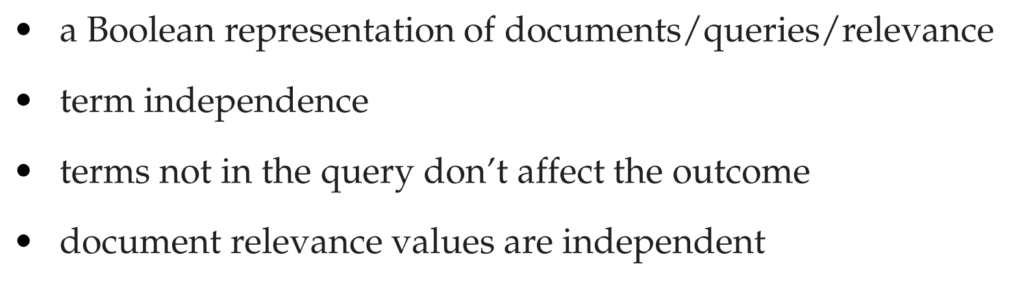
11.4.1 An appraisal of probabilistic models

Slide 20
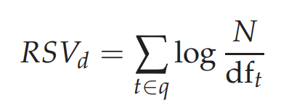
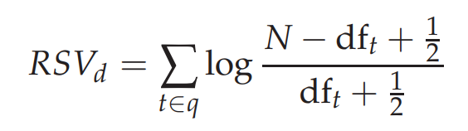
11.4.3 Okapi BM25: a non-binary model
the absence of relevance feedback information (that is, s=S=0)
and
Remark: each term may or may not be negative. If so, we use 0.

Slide 21
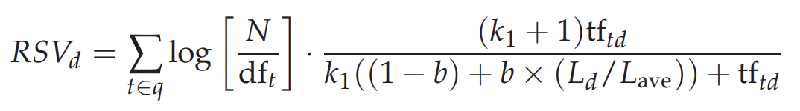
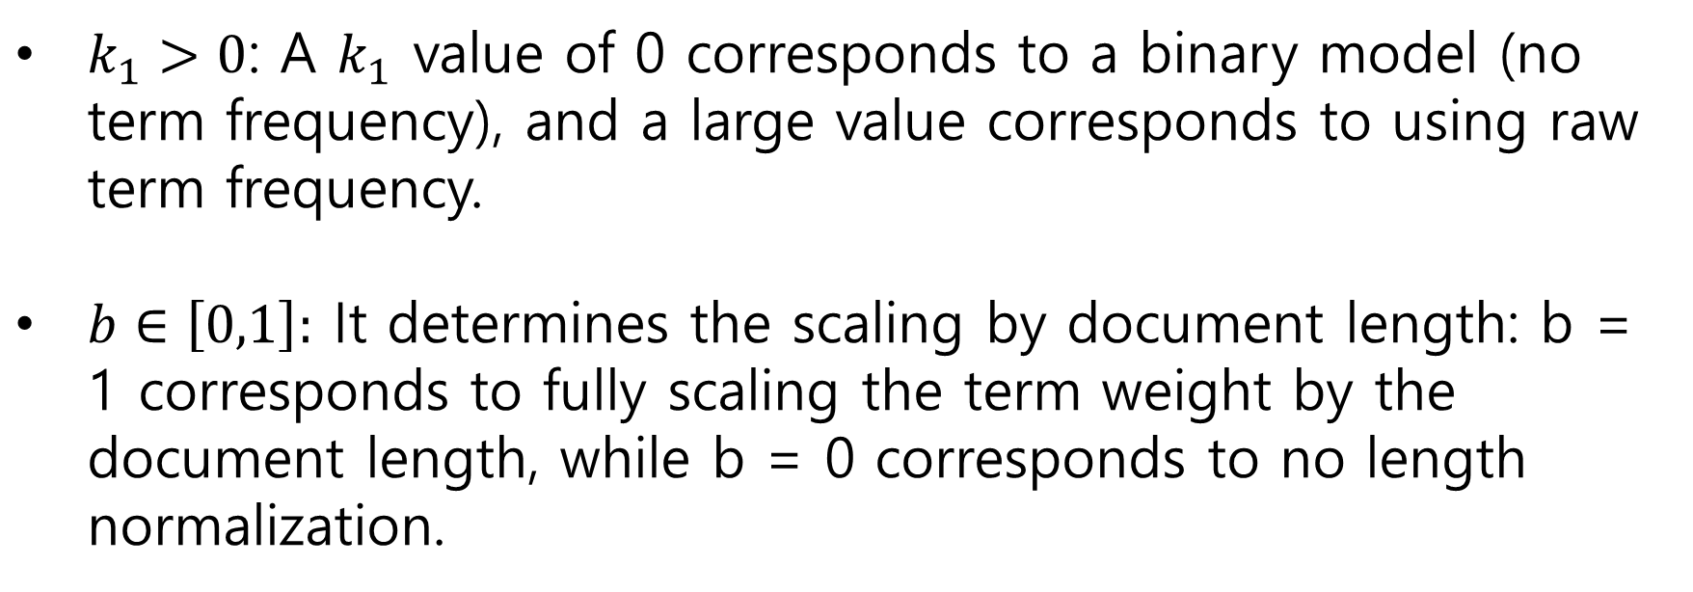
11.4.3 Okapi BM25: a non-binary model
$k_{1}>0$: A $k_{1}$ value of 0 corresponds to a binary model (no term frequency), and a large value corresponds to using raw term frequency.
$b∈\left[0,1\right]:$ It determines the scaling by document length: b = 1 corresponds to fully scaling the term weight by the document length, while b = 0 corresponds to no length normalization.

Slide 22
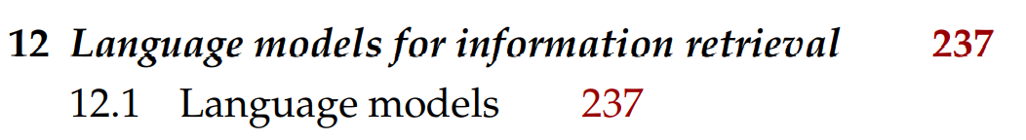
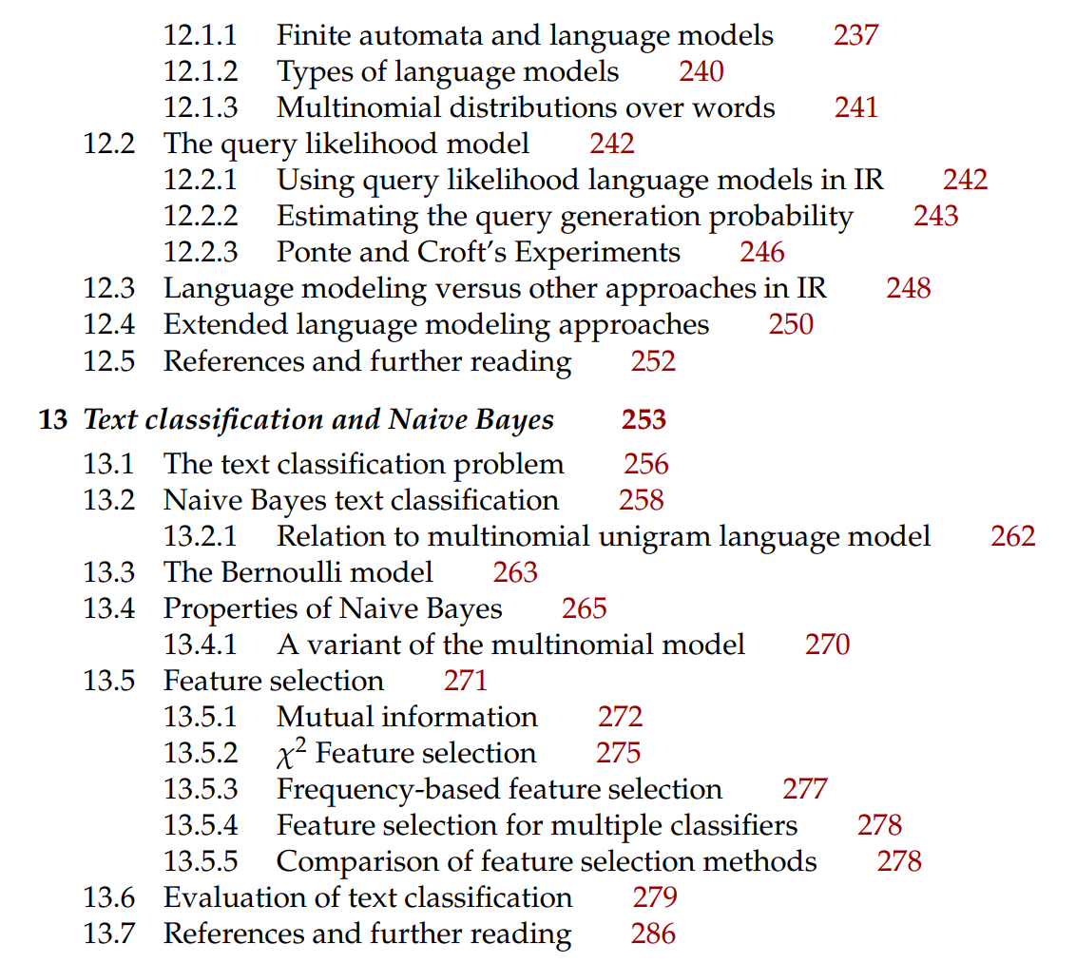
Next Contents

